Slide 1
Kinematics and timing of Tertiary extension in the western Lake Mead region, Nevada
Extensional tectonic regimes produce a variety of structures that are assumed to be kinematically compatible and contemporaneous
This paper tests those assumptions
E. M. Dubendorfer and D. A. Simpson., 1994
Presented by Angelica Rodriguez
Dubendorfer and Simpson, 1994
Notes:
Location is interesting because this is an area in the Basin and range where extension changes style.
To the south of the Lake Mead area there is a chain of core complexes that exposed ductilely deformed rocks in the hanging walls of regional detachment faults
And to the north of Lake Mead transverse structures are responsible for extension
In between is an area of transition, where this study takes place that has both core complex style type detachment systems and strike slip faulting.
This area of transition resulted in a wide array of features other than normal faults.
Like strike slip faults, reverse faults and folds.
Explaining these features is a controversial field, however most models have one assumption: that most of the structures are kinematically compatible, developed and operated contemporaneously.

Slide 2
Assumptions
Tectonic Setting
Evaluating kinematic compatibility
Asses miocene extension direction
Evaluate existing miocene extension models
Style of extension changes to the north and south of field area
Three main structures
Dubendorfer and Simpson, 1994
Notes:
Las Vegas Valley shear zone, Lake Mead fault system, and the Saddle Island fault

Slide 3
Stratigraphic framework
Dubendorfer and Simpson, 1994
Tertiary sedimentary and volcanic rocks lie with minor angular discordance on Triassic to Cretaceous rocks.
Miocene rocks subdivided into three sequences
Horse Spring Formation
Red Sandstone Unit
Muddy Creek Formation

Slide 4
Regional Stratigraphic Framework
Study area divided into three areas
Frenchman Mountain Block
Most complete tertiary section
Topographically higher due to limestone pinching out
Muddy Mountains Block
Complete horse spring formation
Interfingering conglomerate suggest LVVSZ was active; marked southern margin of basin
Boulder Basin Block
Post Horse Spring units indicate this was topographic low
Structural inversion
Due to Bitter ridge limestone clasts in the south
Dubendorfer and Simpson, 1994

Slide 5
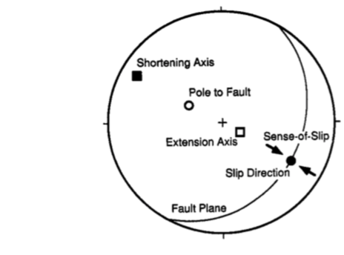
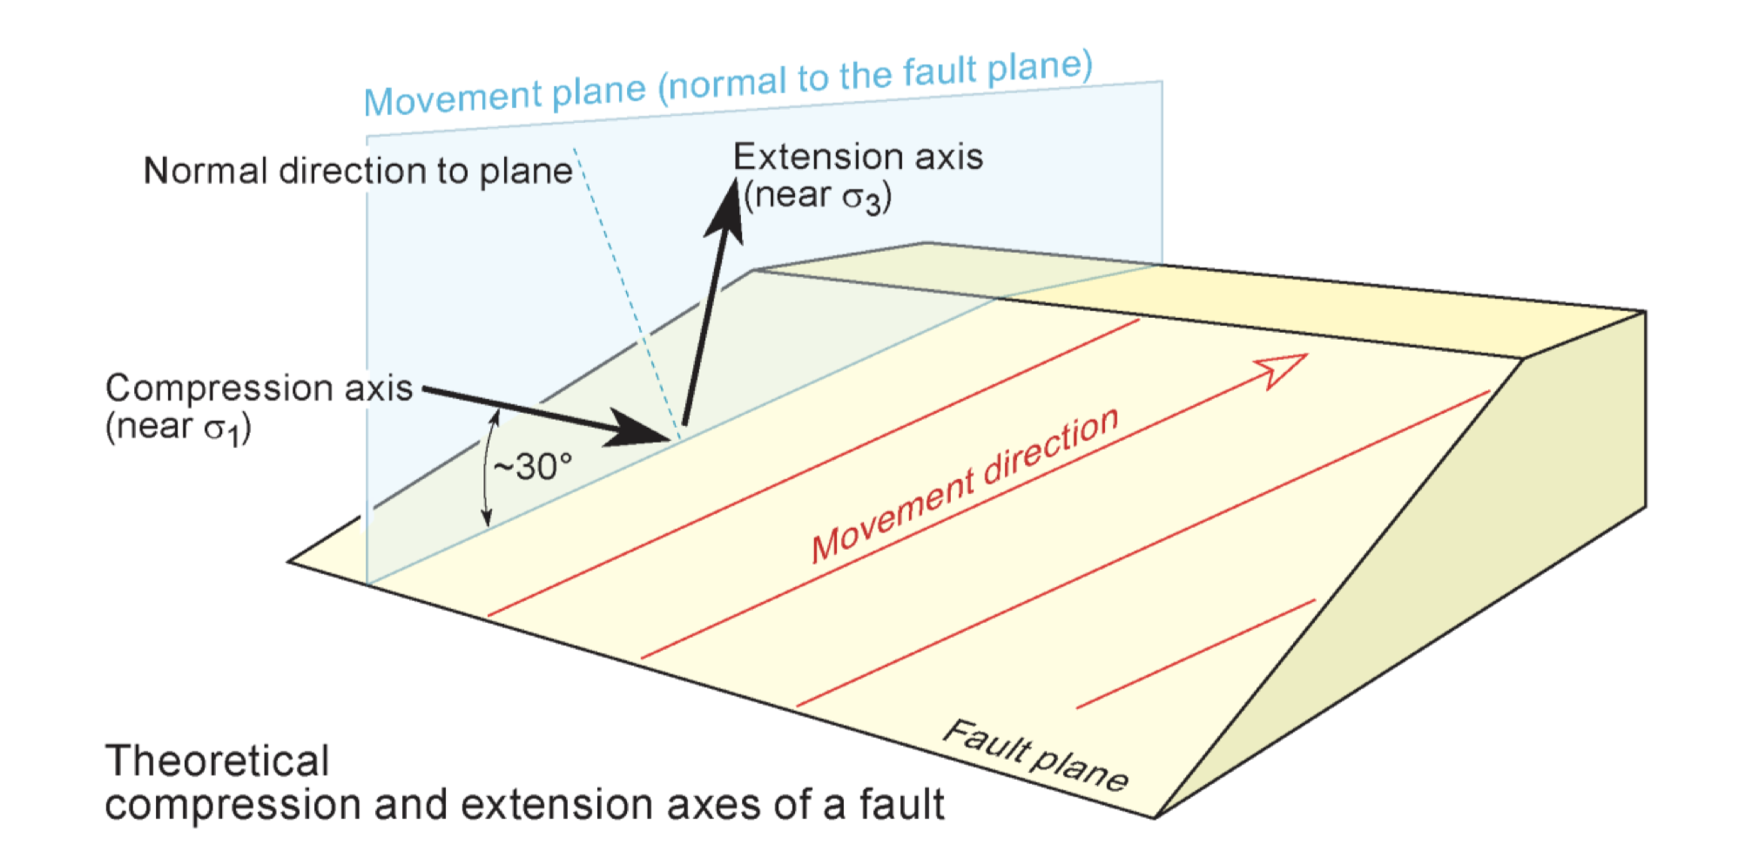
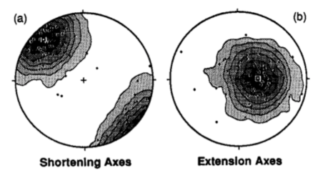
Structure
Method: Marrett and Allmendinger
Collect kinematic indicators
Shortening and Extension axes are contoured for a set of faults
Marrett and Allmendinger vs dynamic approach
Pros: Reactivated faults don't cause erroneous results
Assumptions
Fault kinematics are scale independent
Early formed faults are not reoriented later
Reactivation under later stress regime did not happen later
Normal to plane
Compression axis (near σ1)
Marrett and Allmendinger, 1990; PDB lecture, 2017
Notes:
Kinematic indicators: fault surface, straie orientation, and sense of slip
Dynamic approach = stress inversion technique
Reactivated faults in M and A method gives component of overall kinematic frameworj vs random paleostress direction
Assumption 1 Justification: Many studies demonstrate the scale in varient kinematics of fault systems
Assumption 2 Justification: Not valid near the LVVSZ where structures have rotated clockwise, so they look at faults away from shear zone since they are compatible with near shear zone faults.
Assumption 3 Justification: some probably were reactivated but large sample size ensures that there are enough non reactivated faults in the data size.

Slide 6
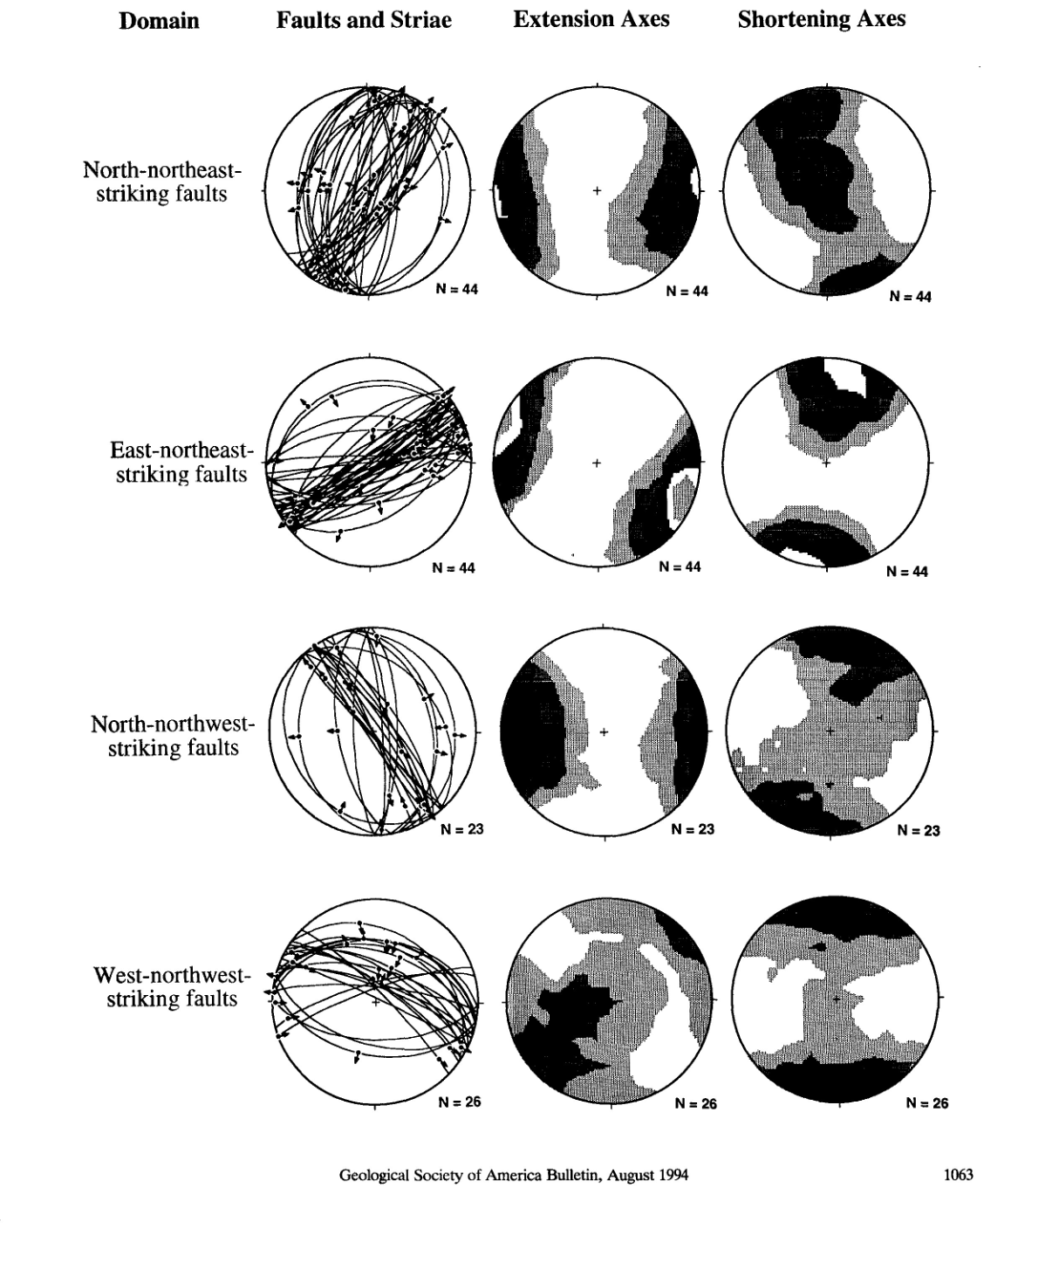
North of Las Vegas Valley Shear Zone
N-NE striking
Left slip and normal faults, bimodal distribution of fault striae suggest two kinematically independent sets
E-NE striking
Similar, probably related to N-NE set
Variation from clockwise rotation of LVVSZ
N-NW striking
Right slip, and shallow normal/ reverse faults, bimodal distribution suggest two kinematically independent sets
W-NW striking
Right slip, reverse faults, N-S shortening consistent with reverse faulting
Kinematically coordinated?
Dubendorfer and Simpson, 1994
Notes:
Combined top: Extension direction east-west, shortening direction north-south and vertical. Right and left slip faults could represent a kinematically linked conjugate fault set and the normal faults could reflect a separate stage of deformation. PROBABLY
Combined bottom: strong maxima and minor submaxima indicate non uniform kinematics, suggest multiple strain fields. NO

Slide 7
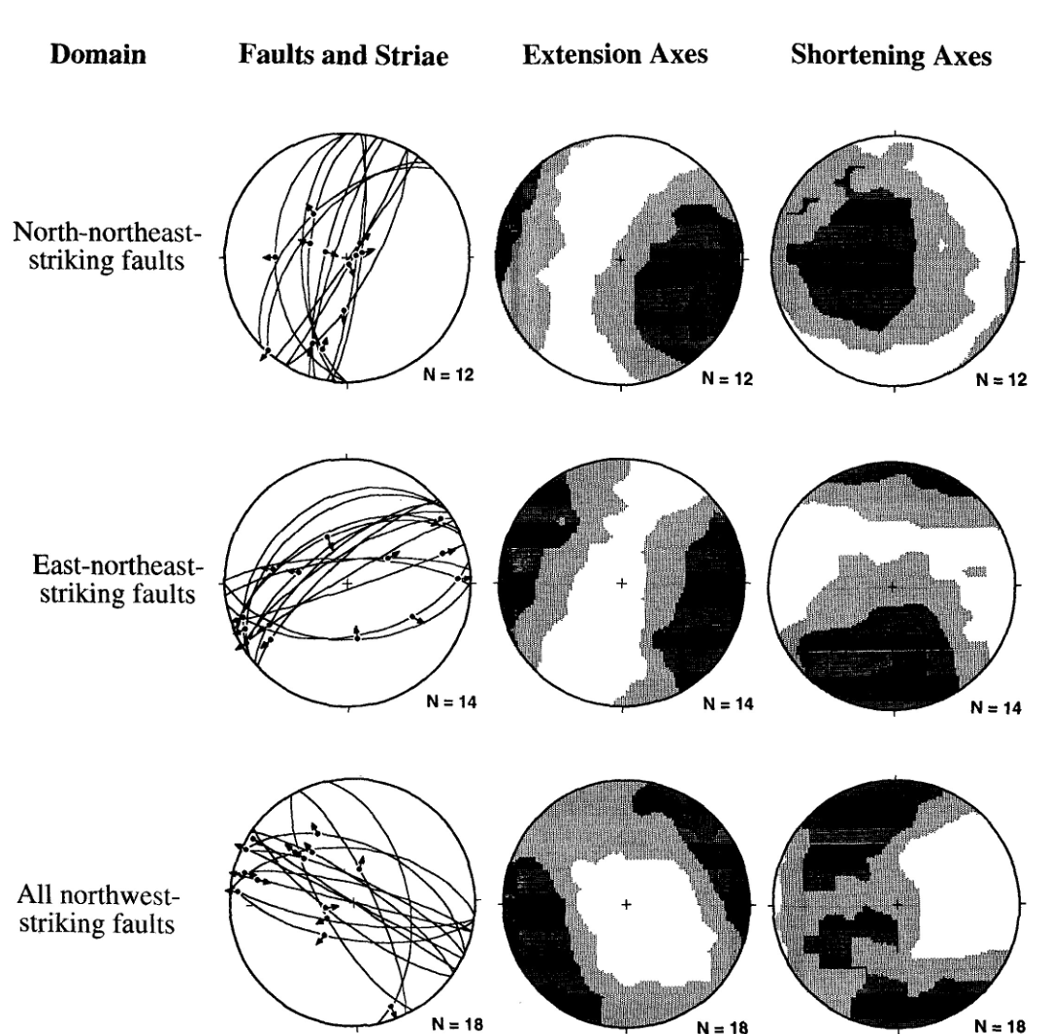
North of Las Vegas Valley Shear Zone
N-NE striking
Left- right slip faults, e-w extension; no obvious shortening direction
E-NE striking
Left slip, normal, reverse faults
W-nw extension; n-s shortening
N-NW; W-NW striking
Normal, right- left slip faults, diffuse maxima indicates unclear kinematics
Kinematically coordinated?
Dubendorfer and Simpson, 1994
Notes:
Less data
Combined top: Extension direction east-west, shortening direction north-south and vertical. PROBABLY
Combined bottom: too much scatter for clear kinematic conclusion. NO
Summary: fault sets are well defined north of the shear zone, undefined south of the shear zone. Data indicates E-W extension; unclear n-s shortening could indicate constrictional strain during extension, change in shortening during extension, or components of both.

Slide 8
Folds
North- Northwest trending folds
In hanging walls of N-NE normal faults
Interpreted either as rollover structures, or extensional fault bend folds
Not related to shortening or strike slip faulting
East- West trending folds
Associated with reverse faults
Reflect localized shortening
Dubendorfer and Simpson, 1994
Notes:
Shortening - shortening would have to be E-W, isnt not
Strike slip faulting- requires dextral or listric faults which ar not seen; rotation is not likely due to open nature of the folds.

Slide 9
Structural Chronology
Oldest to Youngest Structural Events
N-NE striking normal faults and NE trending folds
Right slip faults associated with and including the LVVSZ
E-NE to W-NW striking reverse faults and E-W folds
NE-ENE striking left slip faults
Dubendorfer and Simpson, 1994

Slide 10
Implications for tectonic models
Model 1
North- South maximum principal stress direction during miocene
Unlikely
Diachronous movement
Folds unexplained
Strike slip faults intersect at ~130° > than m-c theory predicts
Localized deformation is from far field stresses
Does Not account for large lateral translations
Model 2
Reorientation of principal stress explains difference in timing between two major strike slip zones
Rejected
Strike slip faults are not likely from reoriented geometry
Paleostress determinations are suspect
Folds not explained
Model 3
Coeval N-S shortening, vertical attenuation, E-W extension due to regional constrictional strain field
Incorrect
Data indicates n-s shortening postdated east west extension
Notes:
All models assume structures are dynamically related and coeval

Slide 11
Proposed Model
Strike slip faults function as transfer faults between terranes of different extension
Contractional structures reflect south directed flow of rocks into areas of high extension
Differential extension can induce gravitational flow of crustal material
Viscous flow model predicts flow parallel to extension and perpendicular to extension
Perpendicular flow could be responsible for lateral breakaways
Notes:
Lateral breakaways are responsible for highly localized contractional features

Slide 12
References
Earnest M. Dubendorfer., and David A. Simpson., 1994., Kinematics and timing of Tertiary extension in the western Lake Mead region, Nevada: Geological Society of America Bulletin, V. 106, p. 1057-1073
Randall Marrett., and Richard W. Allmendinger., 1990., Kinematic analysis of fault slip data: Structural Geology, Vol. 12, No. 08, pp. 973- 986
JPB lecture., 2017, Paleo-stress analysis from fault data: Lecture “paleostress calculation”

